Slide 1
Ford-Fulkerson Algo
By-
Akanksha Sharma

Slide 2
Ford–Fulkerson algorithm (FFA) is a greedy algorithm that computes the maximum flow in a flow network.
It was published in 1956 by L. R. Ford Jr. and D. R. Fulkerson.

Slide 3
Problem Statement
Given a graph which represents a flow network where every edge has a capacity. Also given two vertices source ‘s’ and sink ‘t’ in the graph, find the maximum possible flow from s to t with following constraints:
a) Flow on an edge doesn’t exceed the given capacity of the edge.
b) Incoming flow is equal to outgoing flow for every vertex except s and t.

Slide 4
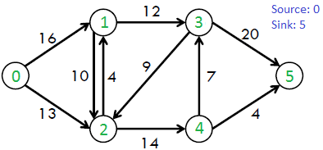

Slide 5
Terminologies
Residual Graph of a flow network is a graph which indicates additional possible flow. If there is a path from source to sink in residual graph, then it is possible to add flow. Every edge of a residual graph has a value called residual capacity which is equal to original capacity of the edge minus current flow. Residual capacity is basically the current capacity of the edge.

Slide 6
Ford-Fulkerson Algorithm
The following is simple idea of Ford-Fulkerson algorithm:
1) Start with initial flow as 0.
2) While there is a augmenting path from source to sink.
Add this path-flow to flow.
3) Return flow.

